Slide 1

Project Audit Three
E-Asset Tracking
Alisha, Dillon, Franklin, Jordan, Rob and Woojin
Notes:
Introduce Clients Emma and Cameron

Slide 2

Project Deliverables
Market Analysis
System Architecture
3. Prototype

Slide 3
Outcomes
Recommendations
Use COTS systems to develop a system highly optimized for an oil rig environment since the market is oversaturated
Most suited companies are Progility Technologies and ReadyTrack
Both address the major requirements
Fusion of devices needed for tracking, fatigue monitoring and sea water detection.
System Architecture addresses high level design considerations
Notes:
Report outcomes
There are established COTS personnel and asset tracking systems that the client can use:
The most suited companies for an oil rig situation were found to be Progility Technologies and ReadyTrack, both of which address most of the major requirements that the client has put forward.
ReadyTrack is preferred by the team as there is more information available on the nature of the technology available.
From all the information that was provided by the respective companies, fatigue monitoring and seawater detection were not found in any of the devices. While there are other COTS devices that perform this function, a fusion of the three devices, tracking, fatigue monitoring and seawater detection, will be needed to ensure that all the requirements of the client are met.
Prototype outcomes
Demonstrates the key principles of an asset tracking device desired in such a situation but to build a better one that is more accurate, etc. we need better parts.

Slide 4
Action tasks since last audit
Drive Management
Rob, Woojin
Audit Preparation
Rob
Poster Preparation
Rob, Alisha, Woojin
Creation of the prototype
Jordan, Dillon
Finalising the report
Alisha, Franklin
Client communication
Woojin
System Architecture
Rob, Woojin
High Level Diagram
Jordan

Slide 5
Communication
Team
Weekly team meetings: Wednesday 8-10am.
Slack communication.
Client
Weekly report to the client to update them on our progress.
Weekly upload of Google Drive to GitHub so the client can access our work.
Fortnightly client meetings.

Slide 6
Implementation of Feedback
Ways of receiving feedback
Observers (Meetings and Audits)
Tutors (Meetings and Audits)
Clients (Meetings, Audits and e-mails)
Team members (Meetings, Slack and Audits)
What we did to improve our project through feedback
Allocated a time slot for it in our meetings
Understanding which pieces of feedback provide useful suggestions
Changing the way in which we approach the project
Feedback is recorded on the Google Drive

Slide 7
Decisions
Team made major decisions in the team meetings.
Slack was used to communicated minor decisions.
Examples of key decision:
We created multiple iterations for the prototype.

Slide 8
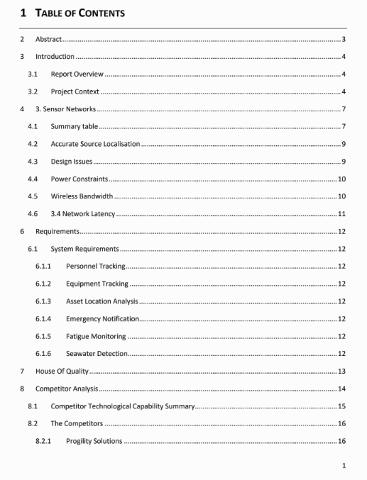
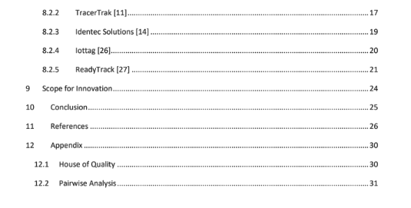
Market Analysis Report
Submitted to the clients.
Handout given
Notes:
Print report and hand out to the observers, tutor and Chris

Slide 9
Prototype
Iteration 1: Wireless transmitting and receiving
Use a basic transmitter and receiver module to validate path loss models and of the shelf product claims.
Iteration 2: Accelerometer
Add an accelerometer to the transmitter module to detect a fall .
Iteration 3: Water Sensor
Add a water sensor to detect a fall into the ocean.
DEMONSTRATION

Slide 10
System Architecture
Two diagrams were made to implement the system architecture.
A simple system Architecture Diagram
https://docs.google.com/document/d/1Wvk6fnx8xc8KloEmQ2GpEe0htF1rWVbOqhFJMfSc5bg/edit#heading=h.4e4t85lev44o
A high-level design diagram
https://docs.google.com/document/d/1uBaQlka2kKjjxAFf-ecPn-z12fI8S6pMDsiTG-vNsPI/edit

Slide 11
Drive Management
GitHub shows the progress of the project over the semester.
GitHub landing page focuses on the prototype.
GitHub wiki tracks everything else.
A copy of Google Drive is present on GitHub.
Google Drive mainly used for internal team management.
‘Old’ subfolders contain pre-audit 3 or outdated information.

Slide 12
Handover
The project is NOT continuing next semester.
Report has been submitted to our clients.
System architecture diagram and summary
Prototype findings and summary

